Slide 1
TOPIC: SETTLEMENT GEOGRAPHY Revision of: Rural Settlements Urban Settlements 24 April 2020

Slide 2
The classification of Rural Settlements
Pattern
Dispersed
Size
Village
Farmstead
Hamlet
Function
Unifunctional
Primary Activities

Slide 3
The Factors of Site, Situation and Distribution of Rural Settlements
Site
Factors
Availability of drinking water
Situation
Factors
The position of a farmstead in relation to the slope
Distribution
Factors
The arrangement of the buildings
The shape (s) of the buildings
Availability of Pastures
Availability of fuel sources
The position of the farmstead in relation to access of transport routes
The arrangement of the streets
Availability of Arable Land

Slide 4
Topics -Urban Settlements
The origin and development of urban settlements – urbanisation of the world’s population;
How site and situation affect the location of urban settlements; and
Classification of urban settlements according to function, such as central places, trade and transport, break of bulk points, specialised cities, junction towns and gateway towns or gap towns.

Slide 5
Urban Settlements
Urban Hierarchies
The concepts of urban hierarchy, central place, threshold population, sphere of influence and range of goods;
Lower and higher order functions and services; and
Lower and higher order centres.

Slide 6
Urban settlements
Urban Structure and patterns
Internal structure and patterns of urban settlements: land use zones; concept of the urban profile; and factors influencing the morphological structure of a city.
Models of urban structure, such as multiple-nuclei, the modern American-western city; the Third world city and the South African city; and
Changing urban patterns and land use in South African cities.

Slide 7
Urban Settlements
Urban Settlement issues
Recent urbanisation patterns in South Africa.
Urban issues related to rapid urbanisation: lack of planning, housing shortage, overcrowding, traffic congestion and problems with service provision;
The growth of informal settlements and associated issues: case studies from the world and South Africa; and
Case studies that show how selected urban areas in South Africa are managing
urban challenges, handling environmental, economic and social justice concerns

Slide 8
Urban Settlements
Urban Settlements – are towns or cities where Secondary ,Tertiary and Quaternary activities takes place.
An increasing amount of people are living in urban areas, so towns and cities are growing larger and more complex all the time.
Remember the reasons why people move from rural to urban areas.

Slide 9
Secondary Activities
Secondary Industries involves the transformation of the raw material into the finished or manufactured goods. This sector has developed because of the demand for more goods and services, and it also helps in the industrialization process.
The examples of various industries are raw wool, which is woven into better quality wool and woolen clothing, wood is converted into furniture, textiles into various clothes and steel is made into cars, aerospace manufacturing, shipbuilding and much more like industries are related to it.

Slide 10
Tertiary Activities
The Tertiary Sector is actually the service sector, which involves the rendering of direct services to its consumers. It supplies services to the immediate consumers and the business houses, and it includes services related to retail, transportation, hotels, sales and much more.

Slide 11
Quaternary Activities
The Quaternary sector is an improved form of tertiary sector as it involves the services related to the knowledge sector.
Universities, IT services

Slide 12
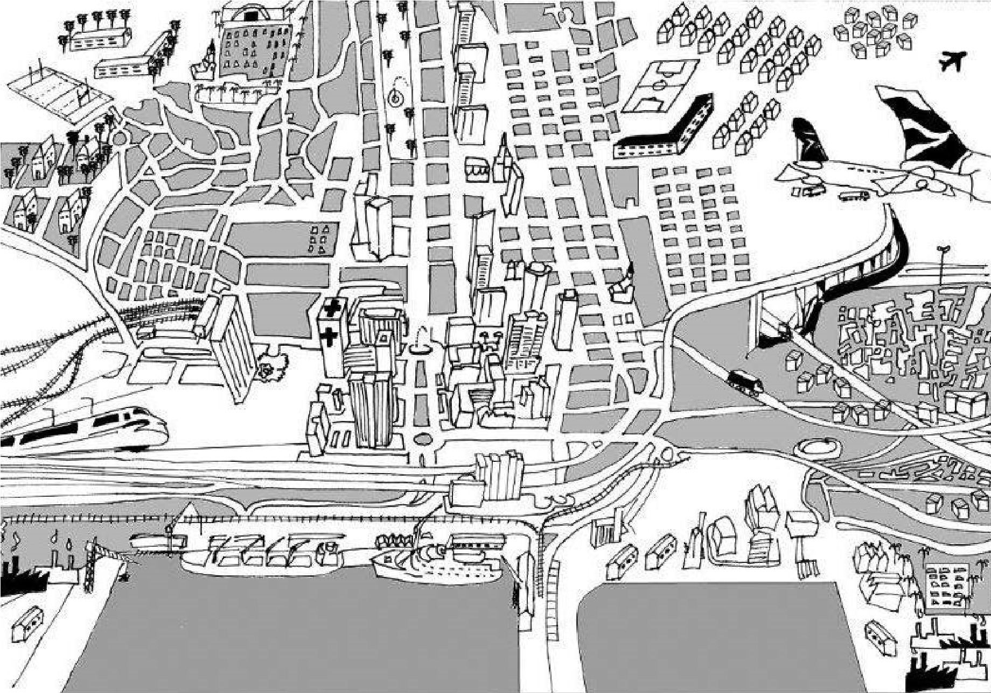
URBAN SETTLEMENTS
Urban Settlements are towns or cities where secondary and tertiary activities take place.
Urbanisation - increase in the proportion of people living in towns and cities.
Urban Growth – The number of people living in the urban area increases naturally (births minus deaths) as well as rural – urban migration.

Slide 13
The classification of Urban Settlements
Pattern
Nucleated
Size
Town
City
Metropolis
Conurbation
Megalopolis
Function
Multifunctional
Secondary, Tertiary and Quaternary Activities

Slide 14
The Factors of Site, Situation and Distribution
The SITE refers to the exact piece of land which is occupied by a settlement and the physical nature of the landscape – relief, drainage, soil characteristics
NB:The SITUATION of a settlement is a broader concept that refers to the relationship of the settlement to its wider surrounding i.e. how is the settlement situated with respect to traffic routes.
NB:The DISTRIBUTION is a much broader concept dealing with all the settlements in an area and its relationship with the environment. The DISTRIBUTION deals with:
(a) PATTERN – The distribution of buildings in respect to each other
(b) INTERNAL STRUCTURE – The distribution of buildings in the settlement according to appearance … the shape of the buildings, the arrangement of the buildings, the arrangement of the streets

Slide 15
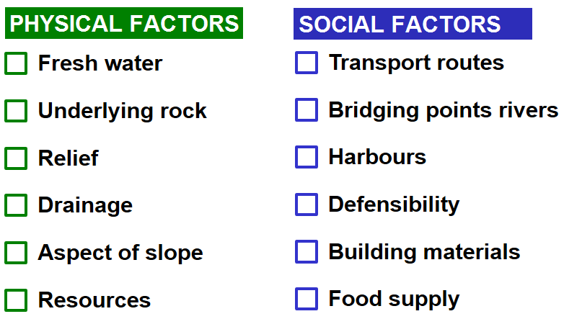
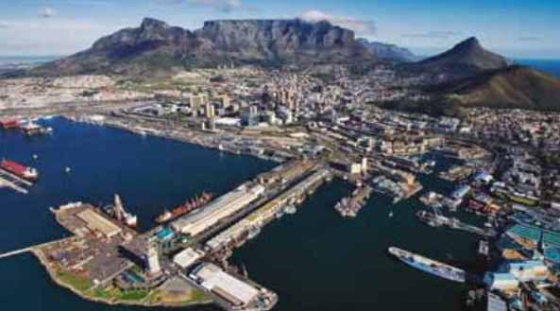
FACTORS INFLUENCING SITE AND LOCATION
Cape Town was established as a Dutch settlement in 1652. The harbour, available fresh water, mild climate, and well-drained land allowed farming to provide provisions to passing ships.

Slide 16
The Distribution of Urban Settlements
This section deals with how can the location and distribution pattern of urban settlements be explained
NB: There are THREE main categories on the basis of the type of factor that determines the location of an urban settlement:
Categories of Urban Settlements
Central Place Towns
Trade and Transport Towns
Specialised Towns

Slide 17
The Distribution of Urban Settlements
Central Place Towns
Commonly referred to as a rural service centre
The central place is always at the centre of its sphere of influence
Trade and Transport Towns
Usually develop along transport routes, junctions or break of bulk points
Usually associated with a number of urban centres developing along a route
E.g.
Break of Bulk point (Ports and Harbors)
Junctions – Railway towns (De Aar/ Touws River)
Gateway – Generally through a physical obstacle/convergence of routes – Worcester
Specialised Towns
These are settlements with one dominant function
Its main function is the provision of a variety of urban services to its surrounding rural population and environment (Sphere of Influence)
E.G.
Mining Towns (JhB)
Holiday Towns (Margate)
Dormitory Towns (Stellenbosch)

Slide 18
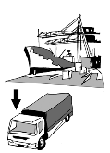
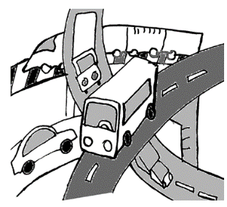
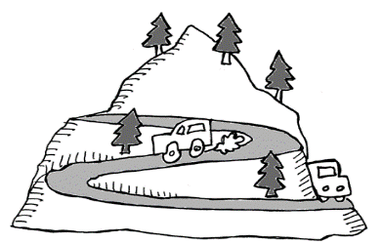
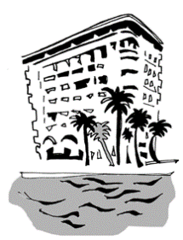
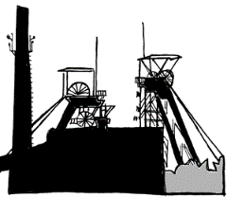
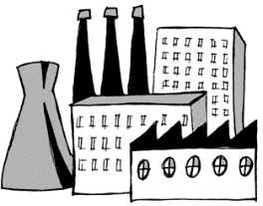
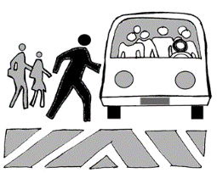
TYPES OF URBAN SETTLEMENTS ACCORDING TO FUNCTION
CENTRAL PLACES
Definition:Supplies urban goods and services to surrounding rural areas
Lower order goods and services Need often(bread, milk doctor) Smaller threshold population. Several shops/services |  |  |  | Higher order goods and services Need less often(health spa) Larger threshold population Less shops/services
2. TRADE/TRANSPORT TOWNS OR CITIES
Definition:Develop where transport routes meet
Break of bulk Transport changes eg from sea to land Cape Town |  | Junction Intersection of two main transport routes. De Aar |  |  |  | Gap Pont of access at physical barrier (mountain pass) Worcester
3. SPECIALISED TOWNS OR CITIES
Definition:Develop because of one main function in the area
Mining Welkom | Education Stellenbosch |  | Industrial Secunda |  | Resort Margate |  | Commuter Soweto

Slide 20
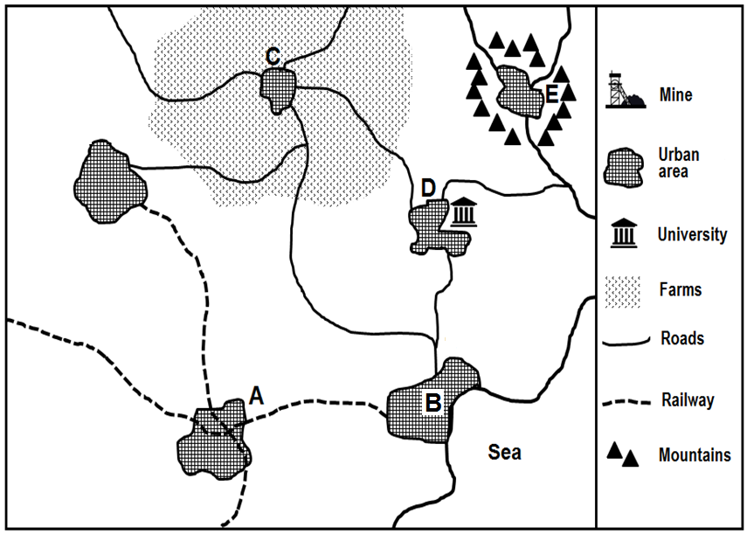
Classify each of the urban settlements A-F on the diagram according to their function

Slide 21
The Distribution of Urban Settlements The Central Place Theory and Distribution
The Central Place Theory offers the best explanation for the distribution of central places.
It is the most influential theory in the understanding of human geography
The foundations of the Central Place Theory were developed by a German Geographer – Walter Christaller
The central place theory involves more than distribution of Central places, Christaller extended the theory to include the HIERACHICAL ORGANISATION and SPHERES OF INFLUENCE of Central Places.

Slide 22
The Distribution of Urban Settlements The Central Place Theory and Distribution
Sphere of Influence
Threshold Population
Range
The area served by a business selling a particular good or service. This is the area where people live who buy goods from a particular shop or use a particular service.
The minimum number of people require to support a good or a service in an urban centre
The maximum distance from which a good or service can draw its customers

Slide 23
The Distribution of Urban Settlements The Central Place Theory and Distribution
Central Places are not the same SIZE
With respect to SIZE it is possible to arrange central places according to a RANKING order.
The URBAN HIERARCHY of CENTRAL PLACES categorises urban centres according to the number and degree of specialisation of functions
Every function has its own threshold population and range
Think about …
Think about the differences of goods and services required on a daily basis (frequently) and goods and services required less frequently

Slide 24
The Central Place Hierarchy
Characteristics
The rank of an urban centre is dependent on the NUMBER and FUNCTIONS offered by the low-order centre.
The NUMBER of low order central places is always higher than high order central places
There are always fewer high order central places.
Since the high order central place has more functions than the low order central place, it will always have a larger POPULATION.
To think about
(According to Christaller, the position of a city or town in the size hierarchy of towns and cities is determined by its position in the functional hierarchy: - The higher its functional rank, the larger its population)

Slide 25
The Distribution of Urban Settlements The Central Place Theory and Distribution
Low-order Centre
High-order Centre
Low- order Service
Central places with a small threshold population, few services and mainly low-order services
Central places with a large threshold population offering many services and mainly high-order services
Things we need virtually every day e.g. daily groceries, bread, milk

Slide 26
LOWER- AND HIGHER FUNCTIONS AND SERVICES
 | Low order functions and services | High order functions and services
Definition | A function or goods you need to buy often | A function/goods not needed regularly
Functions/services | Less specialised | Highly specialised
Threshold population | Smaller number of people | Larger number of people
Range | Small | Large
Sphere of influence | Small | Large
Distance travelled | Near | Far
Number of shops or services | Many – needed on a regular basis | Few – not needed very often
Examples | Bread, milk, petrol station, bottle store, doctors, mechanics | Lounge suites, cars, computer hardware, health spas, specialist doctors

Slide 27
The Urban Hierarchy
The position of a town in the hierarchy is determined by its function, not necessarily by its population size.
In 1967 Professor RJ Davies (South Africa) developed EIGHT hierarchical categories based on the classification of the number and type of functions offered by an urban settlement.

Slide 28
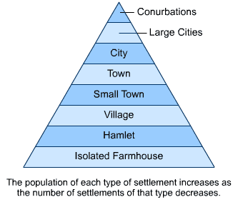
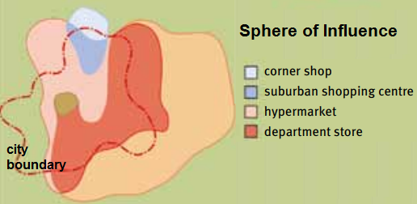
URBAN HIERARCHIES
URBAN HIERARCHY
The ranking of urban areas according to the criteria of size, number of functions and the degree of specialisation of the functions
C
O
N
C
E
P
T
S
CENTRAL PLACE
A town that supplies urban functions to the surrounding rural area
SPHERE OF INFLUENCE
The area served by a central place
THRESHOLD POPULATION
The number of people a function must serve to be profitable
RANGE OF GOODS
The maximum distance that people are prepared to travel to obtain goods or a service

Slide 29
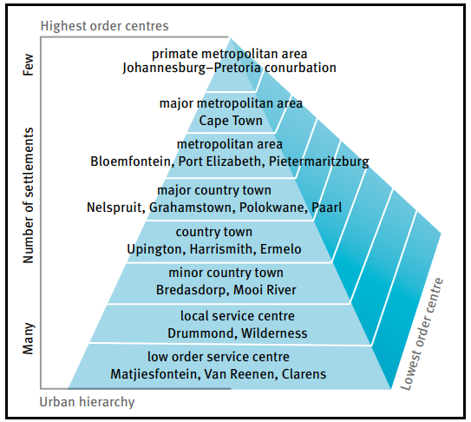
LOWER- AND HIGHER ORDER CENTRES
More lower order centres.
Few higher order centres
Position of settlement .determined by number of functions and not the size of the population.

Slide 30
Refer to the TYPES OF SETTLEMENTS which shows two types of settlements (A and B). Match the settlement types A and B to the statements below.
1.1.1 This type of settlement is unifunctional
1.1.2 Associated with tertiary activities
1.1.3 The smallest of all the settlement types
1.1.4 These settlements are always nucleated
1.1.5 This settlement has a dispersed pattern
1.1.6 An overconcentration of activities
1.1.7 A metropolis is an example of this type of settlement
1.1.8 An example of a central place

Slide 31
ASSESSMENT 1 – UNDERSTANDING SETTLEMENT CLASSIFICATION AND URBAN SETTLEMENT HIERARCHY
1.3.1 Name the settlement type that will be found at A.
1.3.2 Why will B have a larger sphere of influence?
1.3.3 Which is the smallest settlement on the hierarchy?
1.3.4 Will the town or the city have a higher threshold population?
1.3.6 Give a reason for the conurbation having a large sphere of
influence.
1.3.7 Will settlement A or B have more high-order functions?
1.3.8 Which urban settlement offers the fewest services?

Slide 32
ASSESSMENT 4 – UNDERSTANDING URBAN SETTLEMENT HIERARCHY CONCEPTS
1.4.1 | Define the terms sphere of influence and range. | (2 x 1) | (2)
1.4.2 | Which product, food or cars, has a larger range? | (1 x 1) | (1)
1.4.3 | Give a reason for your answer to QUESTION 4.3.2. | (1 x 2) | (2)
1.4.4 | Comment on the threshold population required for motor vehicle
 | sales. | (1 x 2) | (2)
1.4.5 | Describe TWO characteristics of settlement A, which is a low-order centre.
 |  | (2 x 2) | (4)

Slide 33
URBAN STRUCTURE AND PATTERNS

Slide 34
Structure of an Urban area
The study of an urban area involves the following 3 areas:
Urban Profile
Urban Street patterns
Urban land use zones

Slide 35
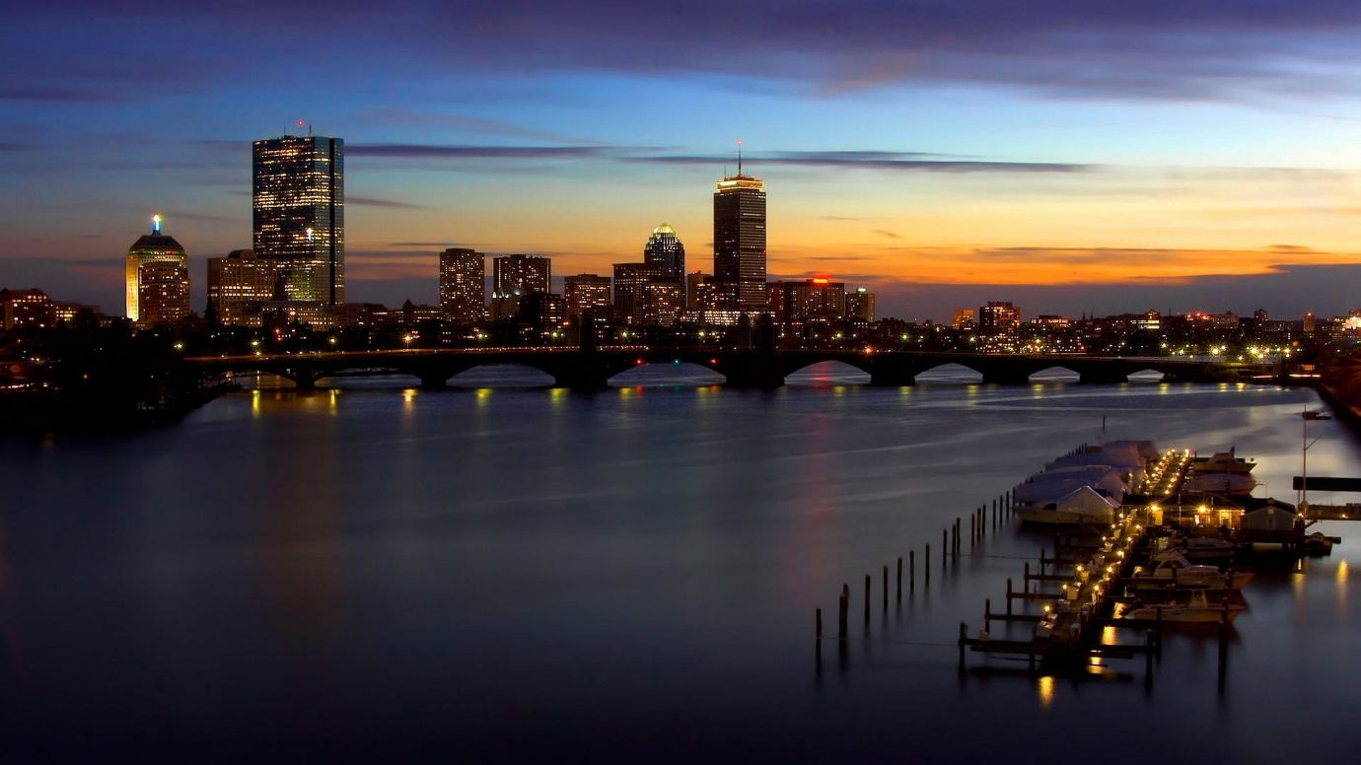
Urban Profile
The view of an urban area from the side
Urban profile takes note of:
The height of the buildings
The density of the buildings
Land value

Slide 36
Why does the height and density of the buildings decrease as you move further away from the city centre?
Buildings become lower
Rural
Residential
CBD
Industries
Transition zone
Cheaper land
Lower density of buildings
Horizontal buildings
Industries
Residential
Land very expensive
Competition
High density of buildings
Vertical buildings
Offices
Commercial

Slide 37
L
A
N
D
U
S
E
Z
O
N
E
S
CBD
Industrial
Residential
Commercial
Zone of decay
Rural-urban fringe

Slide 38
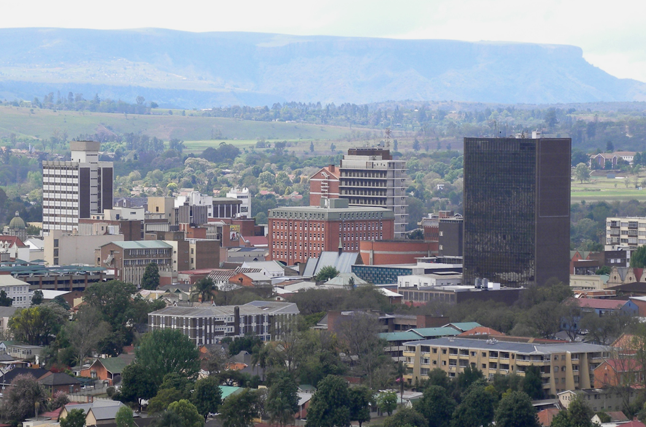
Land-use zones
CBD
Where? | Characteristics
Most accessible Where transport routes meet In the city centre | Highest land values Highest building density Tallest buildings Concentration of shops and offices High-order commercial functions

Slide 39
Land-use zones
INDUSTRIES
Land use zone |  | Where? | Characteristics
Industries | (a) Light industry | Often near CBD or residential areas In planned industrial estates Near road transport | Little noise and air pollution No heavy machinery
 | (b) Heavy industry | On outskirts of the city on cheap land Near major road and rail networks On flat land Near water source | Lots of air and noise pollution Dangerous

Slide 40
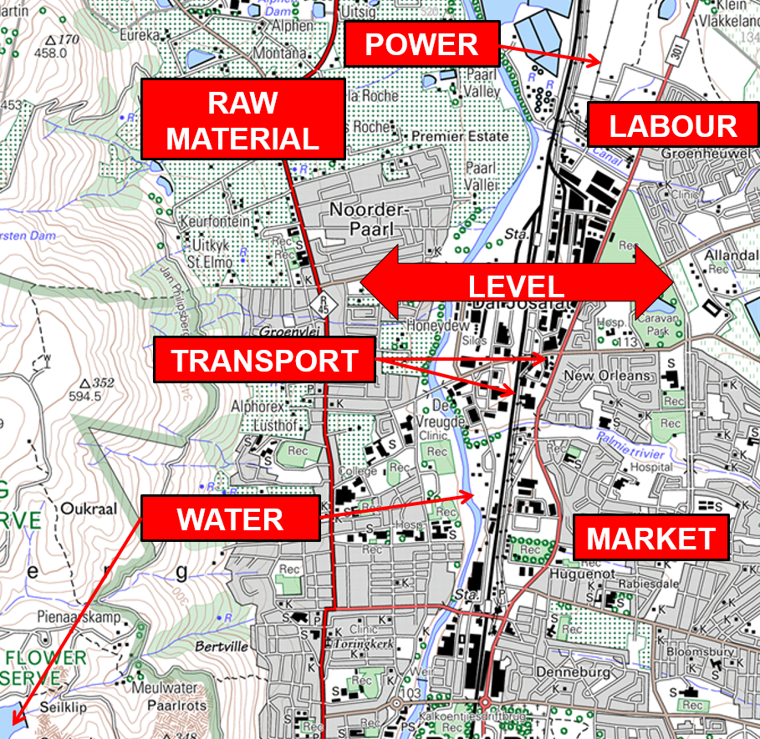
FACTORS INFLUENCING THE LOCATION OF INDUSTRIES
Discuss the factors that influenced the location of industries in Paarl?
FACTORS
Level
Raw Material
Water
Labour
Power
Transport
Market

Slide 41
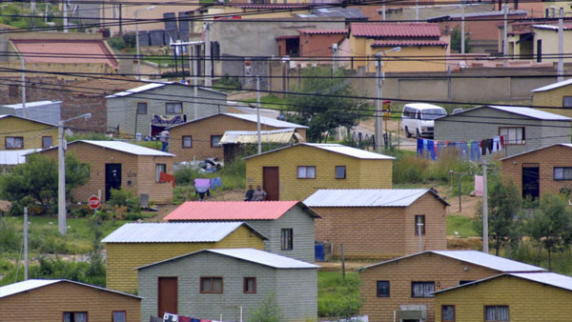
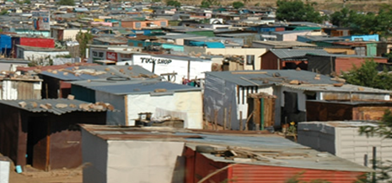
Land-use zones
RESIDENTIAL
Land use zone |  | Where? | Characteristics
Residential | (a) Middle to high income | Found away from CBD Good view | Larger properties Good services Recreational areas
 | (b) Low income | Closer to CBD | Houses close together Fewer facilities Poor services Smaller properties
 | (c) Informal settlement | On the city outskirts | Houses built out of plastic, wood, zinc Unhealthy conditions No service delivery Poverty Crime NB also positive characteristics

Slide 42
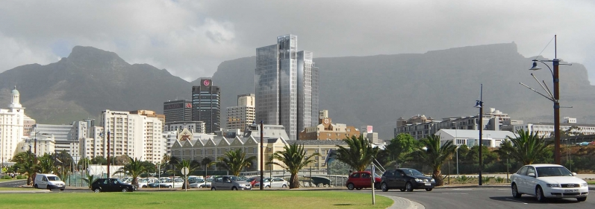
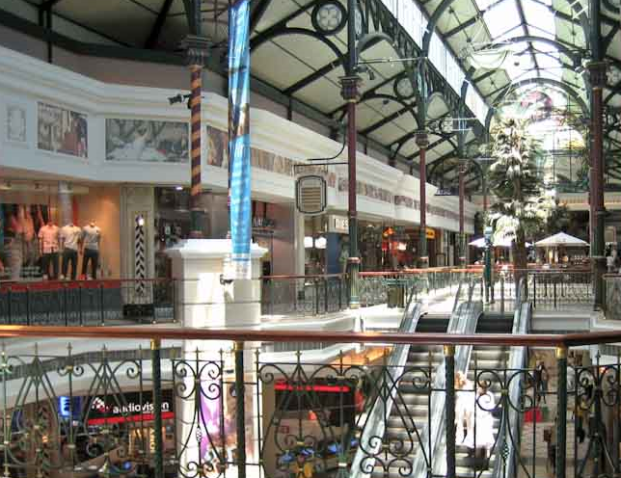
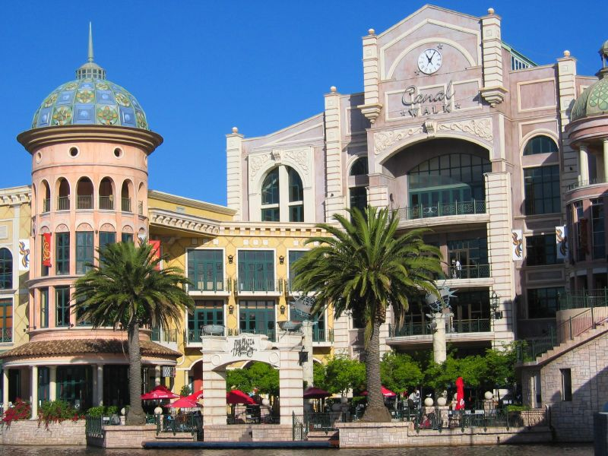
Land-use zones
COMMERCIAL
CBD the commercial heart of the city
Decentralised to shopping malls like Canal Walk

Slide 43
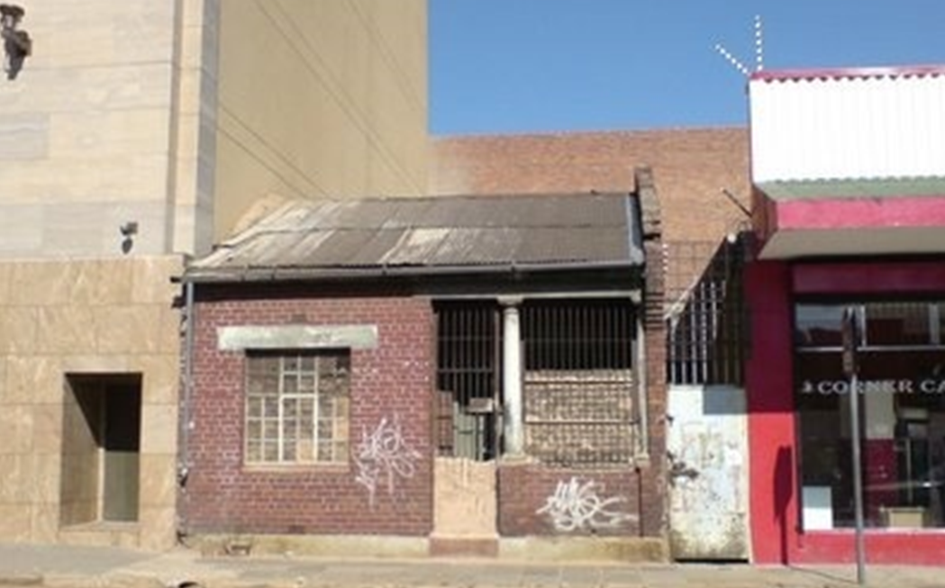
Land-use zones
ZONE OF DECAY / TRANSITION ZONE
Land use zone | Where? | Characteristics
Zone of decay (Transition zone) | Just outside the CBD | Mixed functions (residential, commercial, light industry) Decayed buildings Renewal Valuable land
HOW MANAGED?
Renovation
Renewal
Reduce housing
density

Slide 44
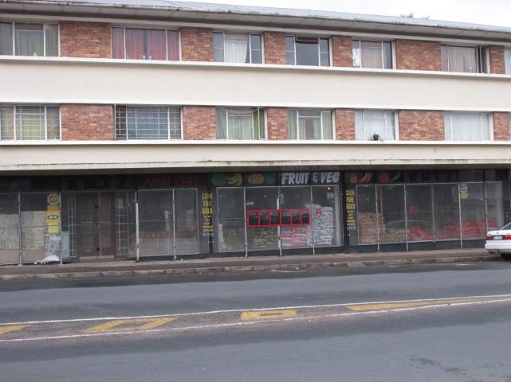
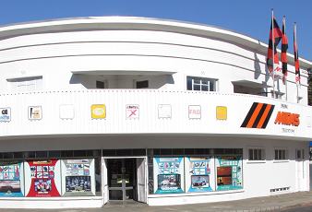
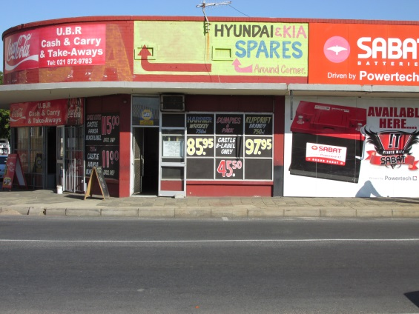
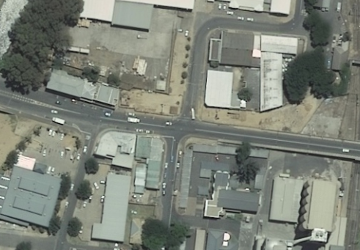
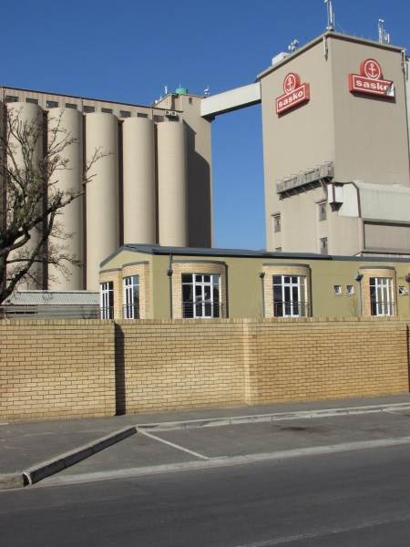
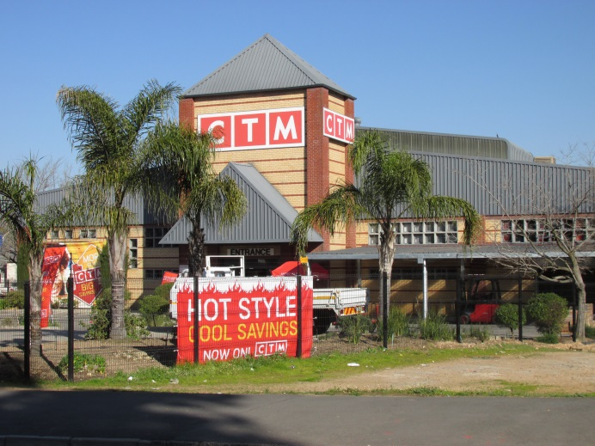
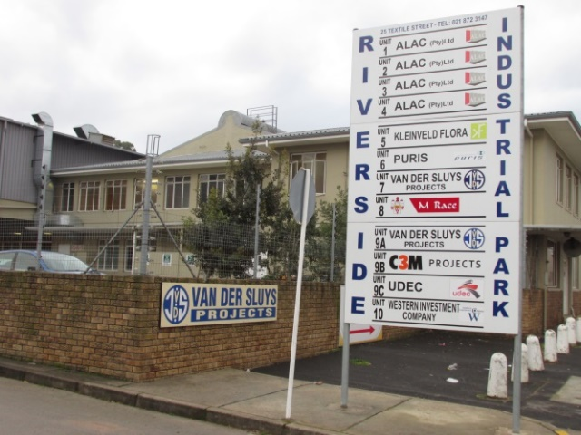
Residential
Commercial
Old buildings
ZONE
OF
DECAY
Old buildings
Mixed
Renewal
Mixed functions
Old buildings
Renewal
Industries
Renewal
Industrial park

Slide 45
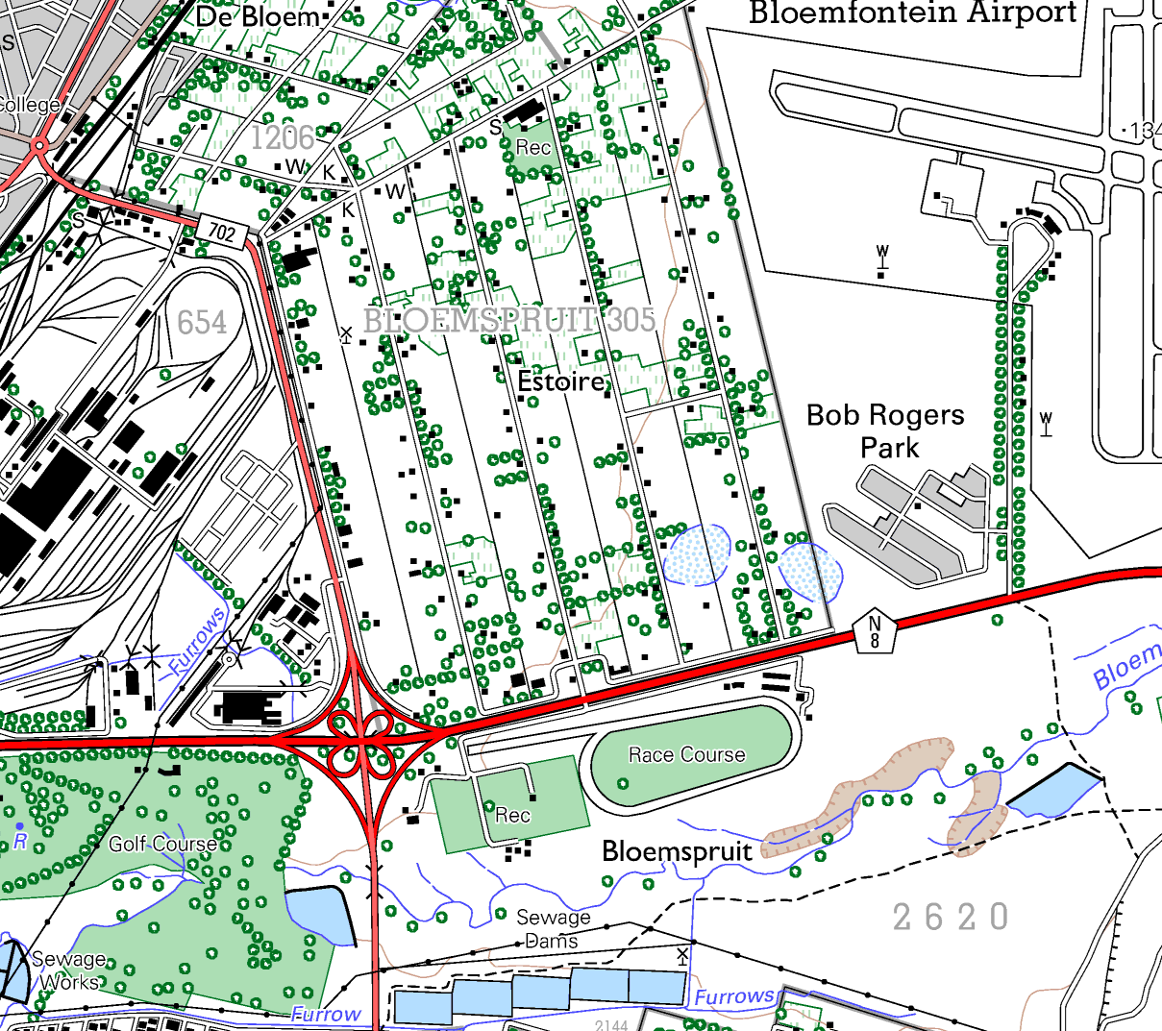
Bloemfontein
Rural-urban fringe
Land-use zones
RURAL-URBAN FRINGE
Functions in rural-urban fringe
Land use zone | Where? | Characteristics
Rural-urban fringe | On edge of urban area | Urban functions invade rural area Both Urban and rural functions Large properties because of cheaper land Plots and small holdings Airports, cemeteries, power stations, golf courses, sewage works

Slide 46
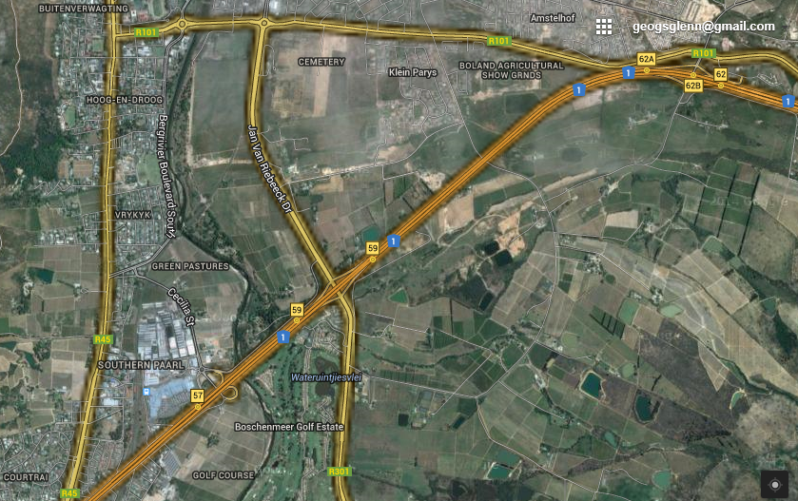
RURAL-URBAN FRINGE OF PAARL
URBAN
Cemetery
Cricket
Power station
Small holdings
National road
RURAL
Paarl
Mall
Golf course
NB -Where?
-Functions

Slide 47
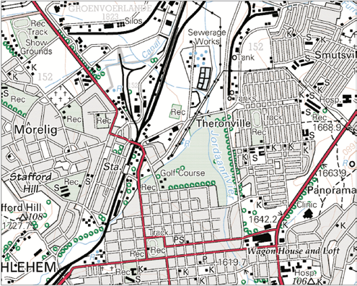
Rural-urban fringe
Residential
Industries
Zone of decay
CBD
Commercial

Slide 48
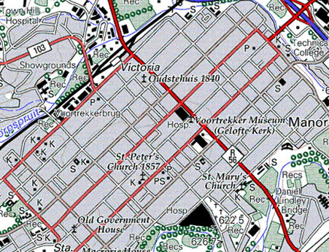
This street pattern
is a major cause of
traffic congestion.
TRUE
FALSE

Slide 49
The CBD will be found at ….
A
D
C
B

Slide 50
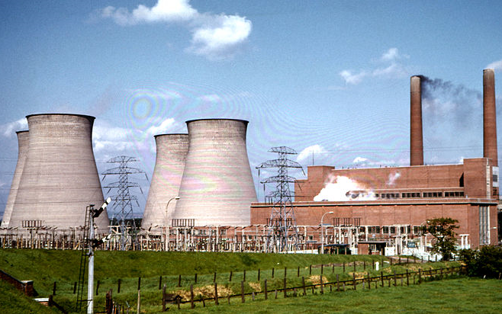
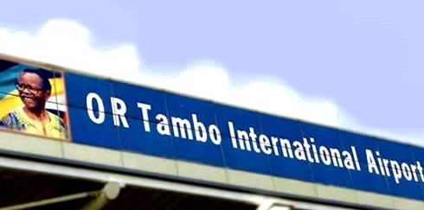
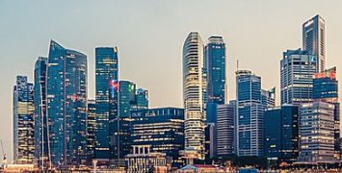
Not found in the rural urban fringe
A
B
D
C

Slide 51
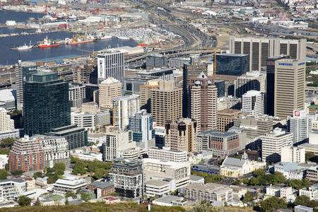
Statement: The buildings are at its highest and most dense in the city centre.
Reason: The value of the land
increases as you move further
away from the city centre.
Choose from the following:
A The statement as well as the reason is correct.
B The statement as well as the reason is incorrect.
C The statement is correct, but the reason is incorrect.
D The statement is incorrect, but the reason is correct.

Slide 52
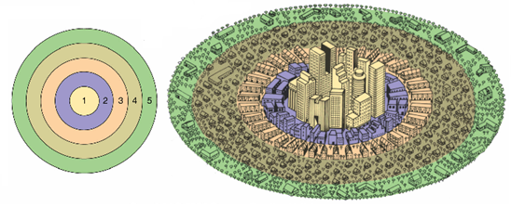
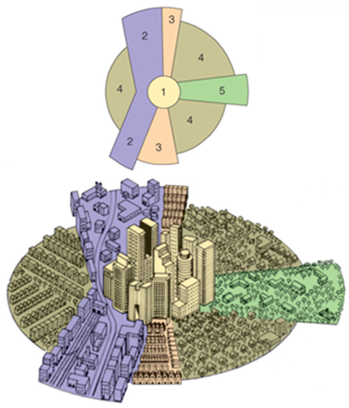
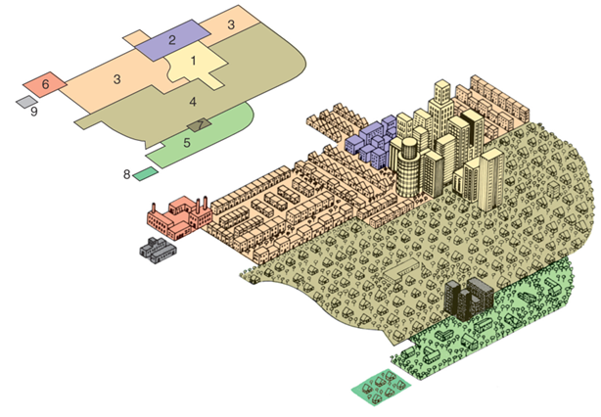
Concentric zone
Models of
urban structure
Sector
Concentric rings around the CBD
Multiple-nuclei
Centres (nuclei) around which activities grow
Sectors radiating from the city centre

Slide 53
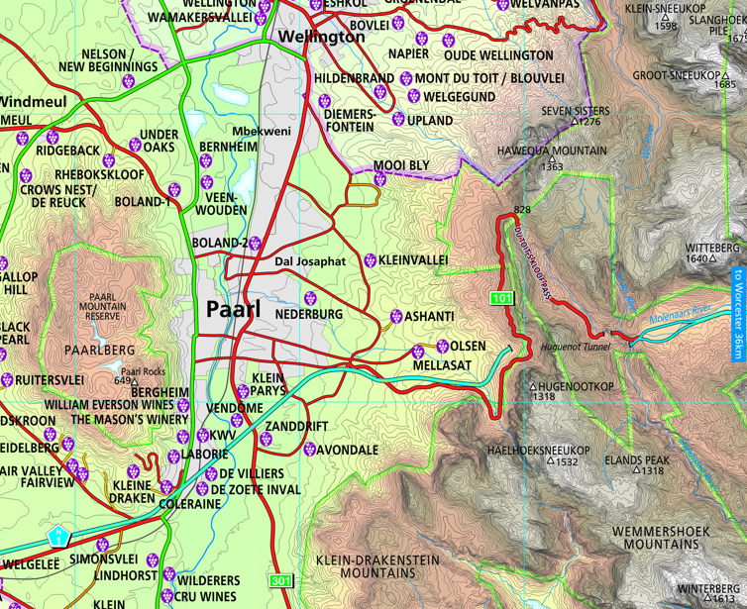
LINIER SHAPE

Slide 54
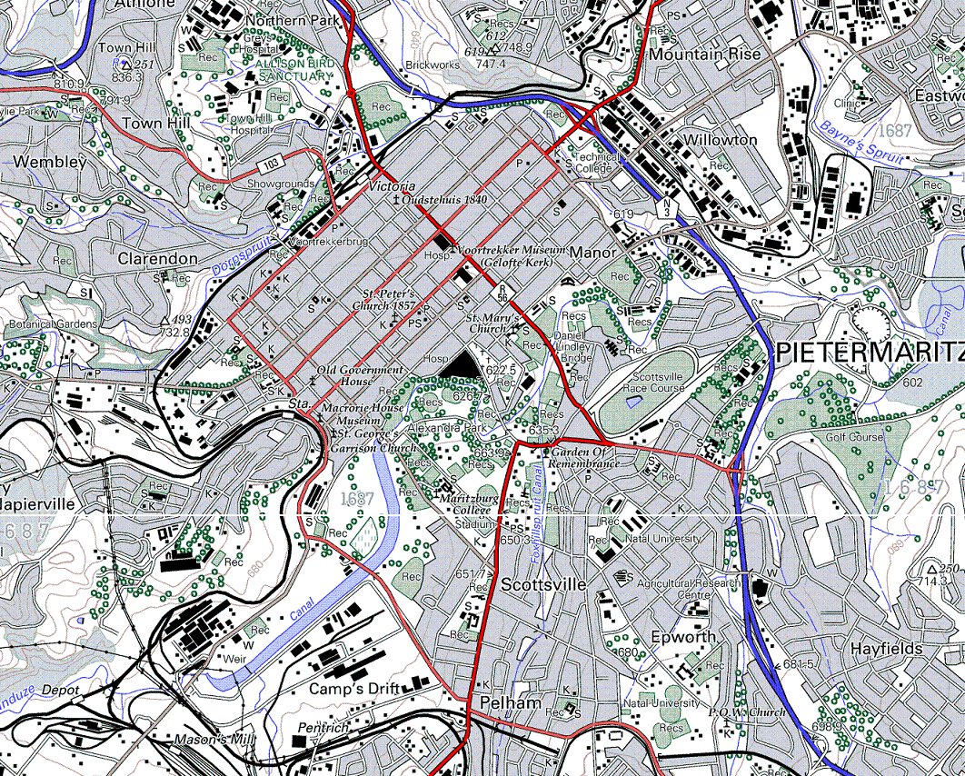
SHAPE
RECTANGULAR
SHAPE
STELLAR
SHAPE

Slide 55
STREET PATTERNS
Name | Gridiron/Rectangular | Radial | Irregular
Characteristics | Roads intersect at right angles | Roads radiate outwards from central point like spider’s web | No clear structure Can be planned or unplanned
Advantages | Easy to plan Land divided easily Easy to find way | Easier flow of traffic All roads lead to central point | Improves traffic flow Fewer intersections Accommodates topography
Disadvantages | Traffic congestion Monotonous Accidents | Traffic jams Traffic is slow Wasted space | Difficult to plan Easy to get lost Not easy to expand or subdivide

Slide 56
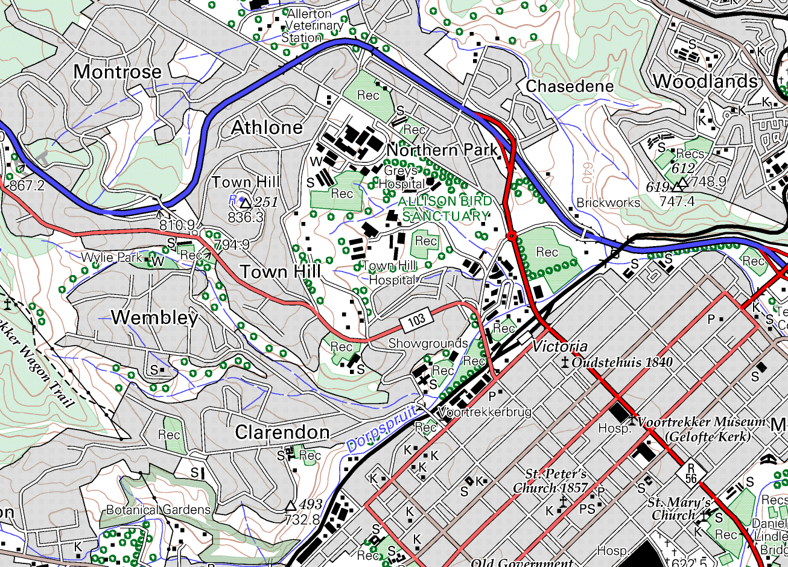
STREET PATTERNS
NB ADVANTAGES AND DISADVANTAGES
IRREGULAR PATTERN
On Steeper slopes
GRID PATTERN
On Gentle slopes
Older

Slide 57
URBAN SETTLEMENT
ISSUES

Slide 58
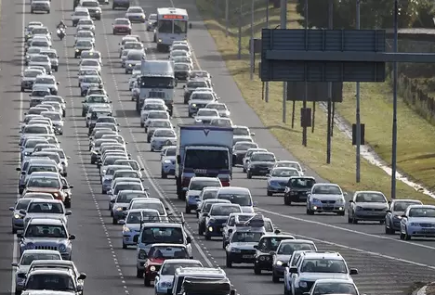
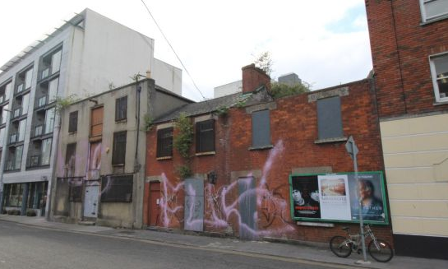
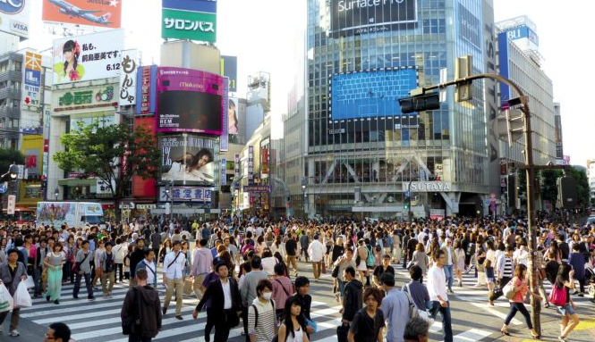
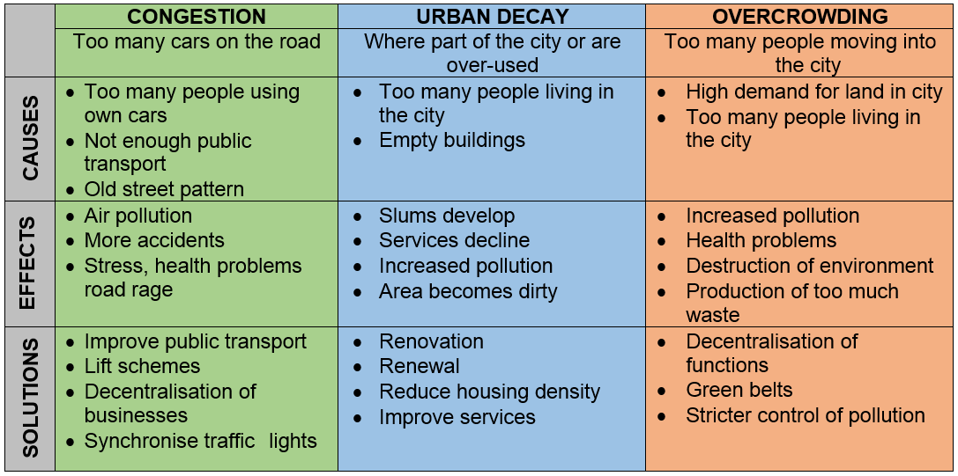
URBAN SETTLEMENT ISSUES

Slide 59
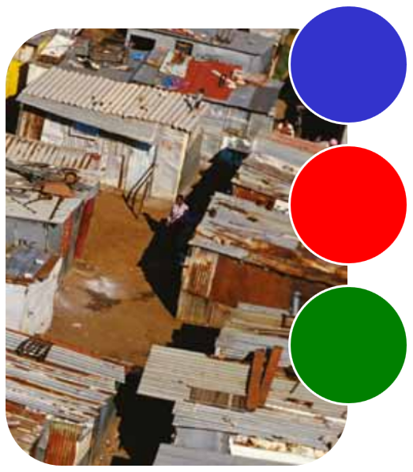
URBAN SETTLEMENT ISSUES
Sometimes illegal settlement of make-shift dwellings made from scrap materials
What
is it?
On the edge of cities. Some can be up to 30 km away from the CBD.
Where
is it?
Informal Settlements
Lack of infrastructure
No proper sanitation, clean water, electricity, refuse removal.
Lack of amenities.
Fire
High population density
Problems
NB How managed?

Slide 60
THANK YOU

